Slide 1

Das Schwarze Hahnchen
CEO/Founder: Derrick Porter
COO: Connor Zanie
CFO: Jeremiah Reid

Slide 2
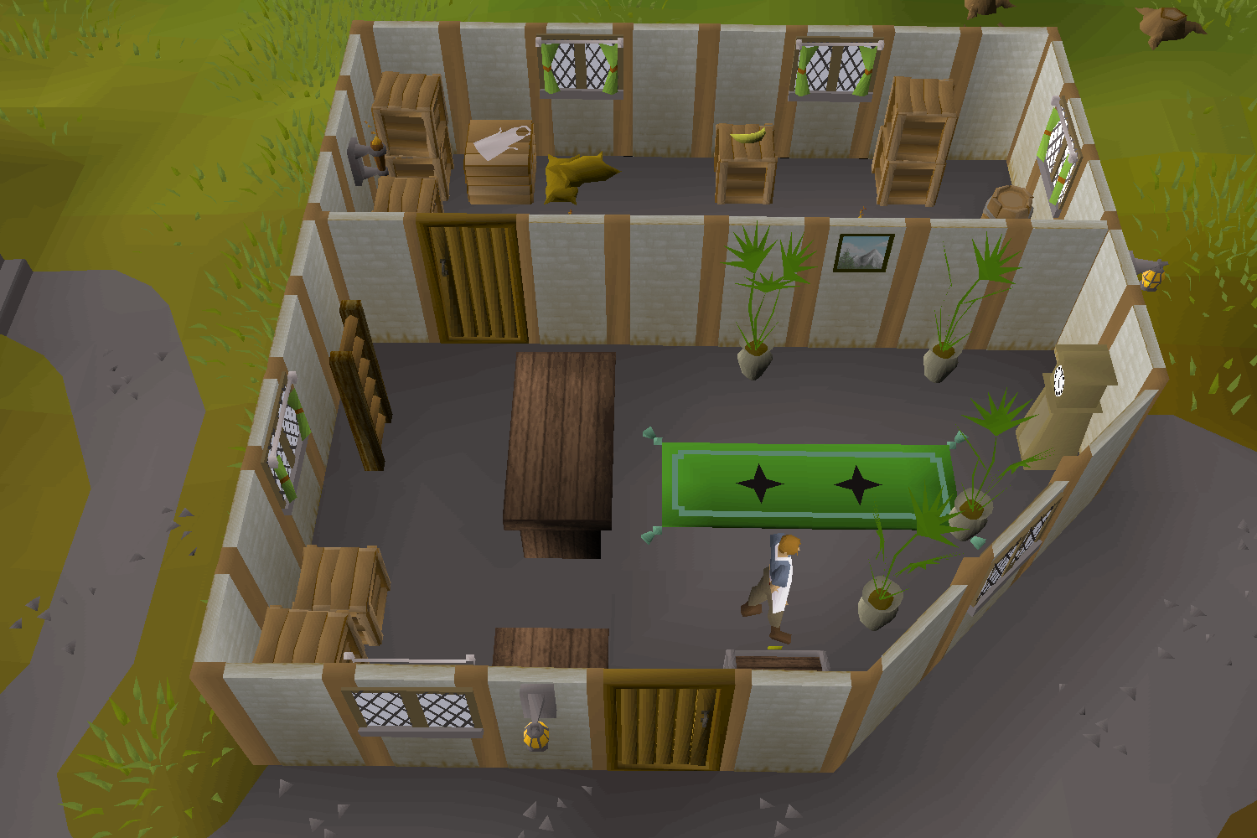
Storefront
Our purpose is to create and serve the best chicken on the market. Not only is our chicken the finest, but so is our delivery service. Which is where our company stands out the most.

Slide 3
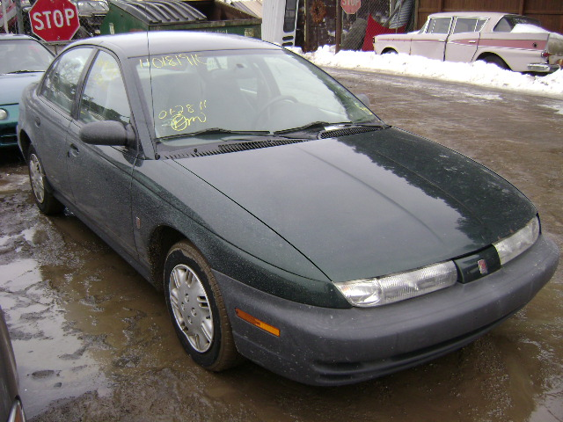

Luxury Delivery Vehicles
With our service, you have prime access to Das Schwarze Hahnchens’ luxury chicken transport vehicles. In addition to your chicken being delivered in style, you are gaining access to our database of chicken certified delivery-boys. Our website will determine if a particular delivery-boy is available or not.

Slide 4
So you only sell chicken and deliver it?
Like that’s all your company does?

Slide 5


Slide 6

In addition to our tier 1 – grade A chicken, we sell the following on our menu:
Bacon
BBQ Sauce
Honey BBQ Sauce
Garlic Parm Dipping Sauce
French Fries
Nachos
Wings
Shrimp
Cheese Sticks
Onion Rings
Smoothies
Milkshakes
Mountain Dew
Pepsi
Dr. Pepper
Sierra Mist
Gatorade
Water
Ice
…..AND MORE!!!
**Cups/Plates/Silverware/Napkins – Bring your own, or rent for additional $1.99/Menu Item**

Slide 7
Wait, you don’t sell salad?!?!?!

Slide 8
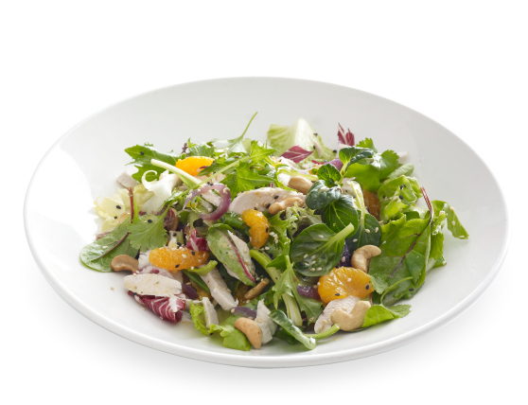

Slide 9
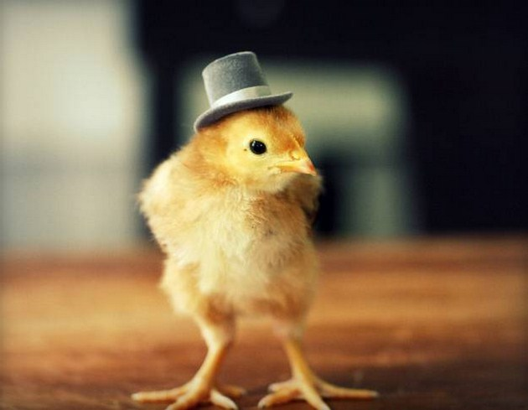
If this power point hasn’t convinced you to come eat at
Das Schwarze Hahnchen, then please take into consideration our chickens which are available for play time during hours of operation – kind of like a meet-n-greet-n-eat….isn’t that neat!

